Slide 1
Analysis of Home Advantage Bias in the Summer Olympics
Group 2
Aluya Omofuma, Elie Tetteh-Wayoe, Jessica Fogerty, Mihir Gadgil and Pierre Bamba

Slide 2
Presentation Objectives
Background
SMART Questions
Methodology
Exploratory Data Analysis
Data Visualizations
Communicate Results
What do the results mean
Summary
Notes:
Background- limitations
EDA- Epicycles of analysis

Slide 3

Background
The Olympics games are a prestigious international sports event that feature winter and summer sports.
Our report focuses on the summer olympic games
We imported the Olympic medal winners dataset from kaggle
Background research helped us arrive at our SMART questions.

Slide 4
Background
We chose to investigate the performance of host nations to see if they had a considerable advantage when hosting.
In a study conducted by Wachtel and Medvedkov, they reported on the pride Russians took in their great performance in the Olympics.
This led us to investigate the performance of Russia during the cold war and compare it to the performance of the USA in that period.
In the first Olympic games, the IOC did not allow female competitors, so we analyzed the data to study the increased female participation in the Olympics over the years

Slide 5
SMART Qs
Does a country have advantage when hosting Olympics compared to when it isn’t?
Specific: Specifically examining host country wins when hosting and not hosting
Measure: Mean of the proportions of medals won as host vs mean of the proportions of medals won as a non host
Answerable: By a paired t-test
Relevant: For training plans and for sponsors to decide which teams to sponsor
Time bound: Data is already available publicly

Slide 6
SMART Qs
When will men and women participation in the Olympic games be equal?
Specific: Specifically examining when women will have equal participation with men
Measure: Projecting when women will have 50% participation
Answerable: Linear Regression
Relevant: For studying progression and equality
Time bound: Data is already available publicly

Slide 7
Questions of Interest
Did the Cold War have an affect on the participation and performance of the US and Russian teams?
Who are the top 5 medal winning countries?
What was the number of medals earned by each country per discipline?
Notes:
We came up with these during out exploratory data analysis

Slide 8
Methodology
Load data from: https://www.kaggle.com/heesoo37/120-years-of-olympic-history-athletes-and-results .
Cleanup data
Insert host country column into the dataset
Change some country codes to simplify analysis
Use the dplyr package to group and summarize the data
Create plots with ggplot2
Fit to the data where necessary
Perform a statistical test where appropriate

Slide 9
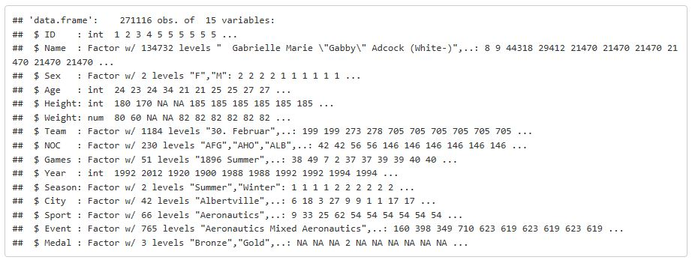
Examine structure of dataset :
We changed the structure of some of the columns such as medal, changed to ordered factor. We dropped Age, Height, Weight, City and Games. Select only the Summer Olympics data.
Insert host country column and data into the data frame.
Change some country codes to simplify analysis.

Slide 10
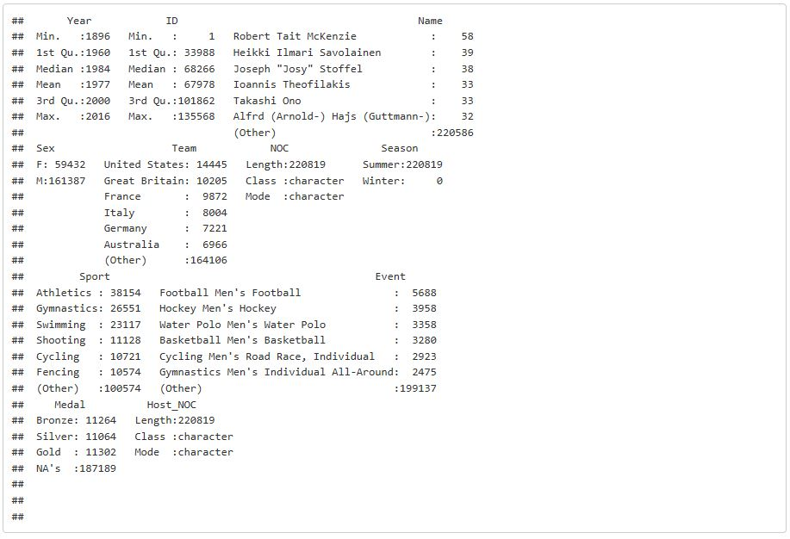
Five Summary Statistics
Notes:
Sex: shows count of each participant by their gender
Team: shows count of each teams participation
Sport

Slide 11
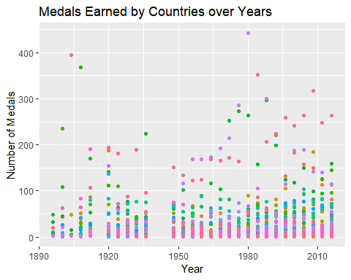
Exploratory Data Analysis:
Notes:
Need ledgend?
The legend takes too much space.
Most countries win less than 100 medals
Better performing countries win over a 100 and the truly exceptional countires win over 200
(as we can see there is a 3-tier ranking of country performance)

Slide 12
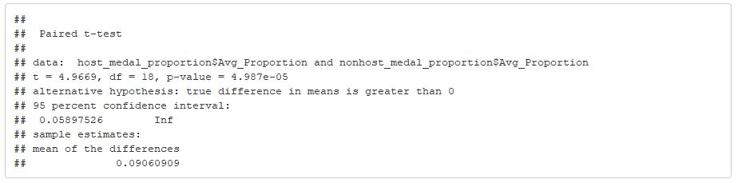

Paired T-Test
The p-value (4.987 × 10⁻⁵) is smaller than the significance level (0.05)
Hypothesis:

Slide 13
T-test result interpretation
μ_{D} is the difference between the average proportion of medals won as a host country and as a non host country
We Conducted a right tailed t-test to check whether a host country gets any advantage or not. Significance level α=0.05
Since the p-value (4.987 × 10⁻⁵) is less than the significance level, we rejected the null hypothesis. This is evidence for our alternative hypothesis, that there is home advantage in Olympics

Slide 14
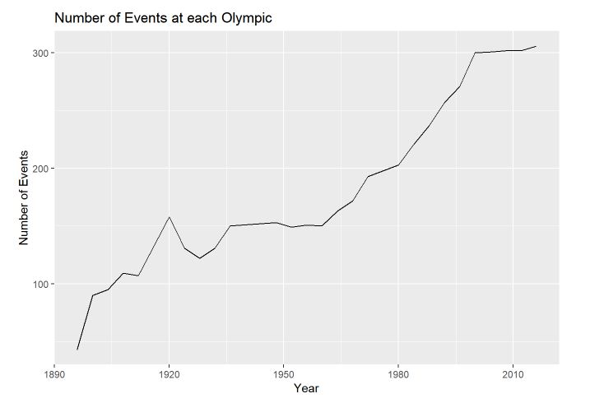
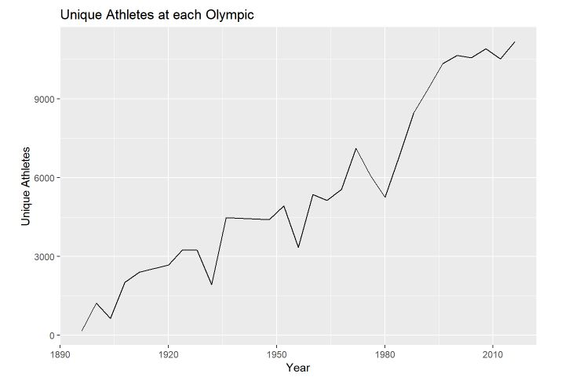
Evolution of Number of Events and Participants

Slide 15
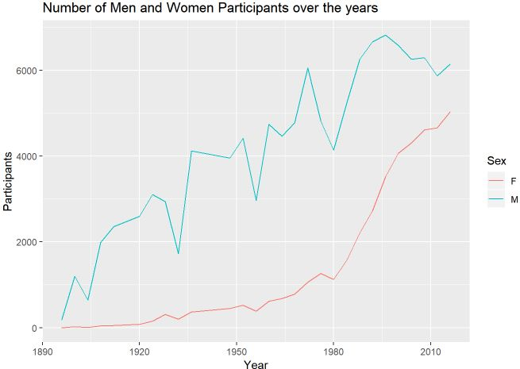
Men vs. Women Participation

Slide 16
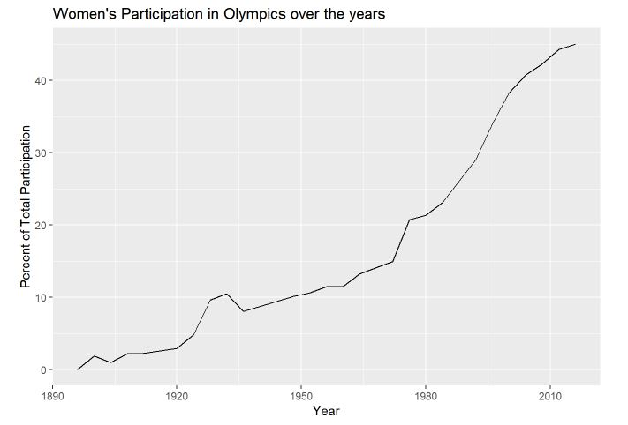
2016: Women participation was at 45%
Notes:
The proportion of women participating each year gives a better picture. As of 2016 45% of the total participants were women.

Slide 17
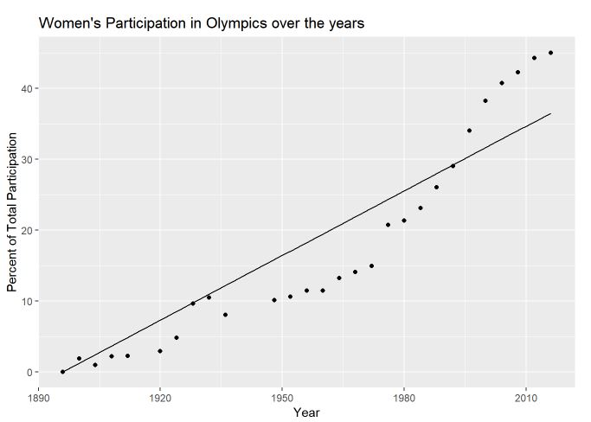
Linear Model for Women’s Participation
The linear model is: Proportion = Intercept + Slope × Year
Slope: 0.304
Intercept: (1896, 0)
Multiple R-squared: 0.9431
Expected 50% year: 2060
Notes:
The slope indicates the rate of increase of women’s participation in percentage. Each year we see .3% more women (1.2% at each olympic games).

Slide 18
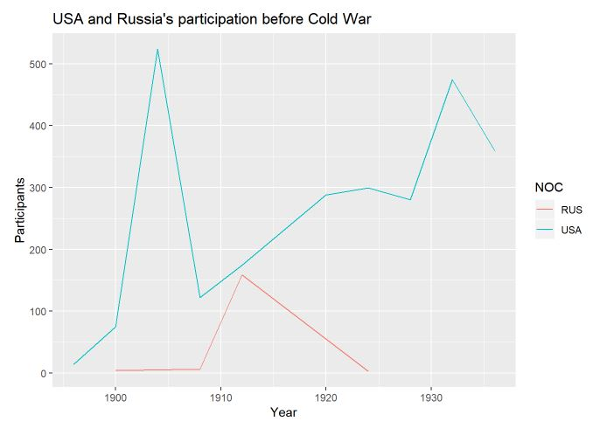
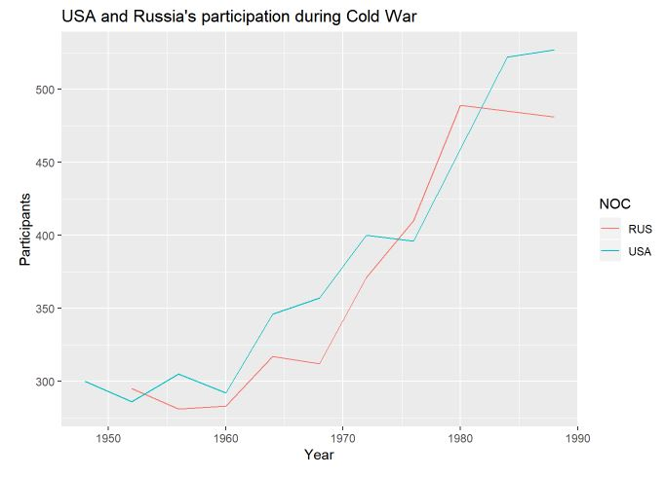
Cold War’s Effect on US and Russian Participation

Slide 19
Number of participants by Russia before the cold war: 172
Number of participants by USA before the cold war: 2609
Total Number of participants by Russia: 3239
Total Number of participants by USA: 3731
Notes:
Make a table instead

Slide 20
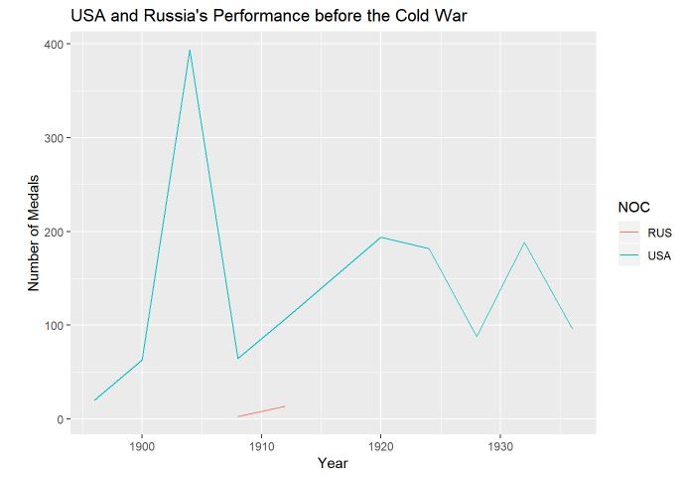
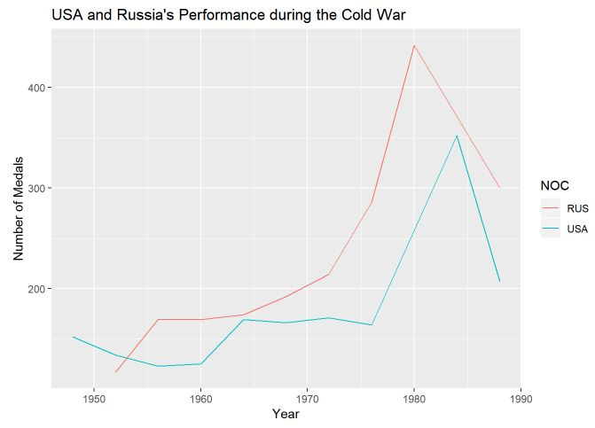
Cold War’s Effect on US and Russian Performance
Notes:
USA did not participate in the Olympics in 1980 and Russia did the same in 1948 and 1984

Slide 21
Number of medals for Russia before the cold war: 17
Number of medals for USA before the cold war: 1398
Number of medals for Russia during the cold war: 2063
Number of medals for USA during the cold war: 1763
Notes:
Russia outperformed USA, in terms of medals won, in almost every Olympic during the Cold War.

Slide 22

Top 5 Medal Winners per Country
USA 4978
GER 3096
RUS 2968
GBR 1946
FRA 1563
Notes:
Indicated economic strength?

Slide 23
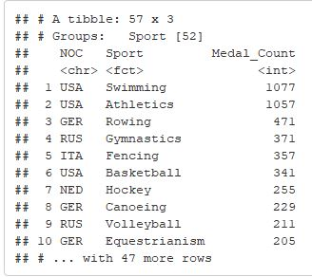
Which discipline has the most events?

Slide 24
Summary
Major highlights from the olympic games:
Performance of countries as host and when not as host
Women participation throughout the olympics from its inception
Cold War effect on Russia and U.S.A
Top medal winners(Discipline and Country)
The focus of this research paper was to determine whether or not a host country had an advantage in the number of medals won other than when not hosting.
Also, the results from the test performed affirmed the thought had in mind.
Russia dominated the USA throughout the cold war.
Again it is quite interesting to note that USA has the highest medal count across all the olympics hosted from its inception.With swimming being the discipline that counts highest to this success.
In a nutshell, I think there should be a regulation to restrict the number of events a country can partake in so to bring about equal likelihood for each country in chase for a medal.

Slide 25

Questions?

